Slide 1
2nd workshop - Data exploratory & Visualization Milan, Oct. 19th 2017
library(dplyr)
rladies_global %>%
filter(city == ‘Milan')

Slide 2

Big thanks to our sponsor & host

Slide 3
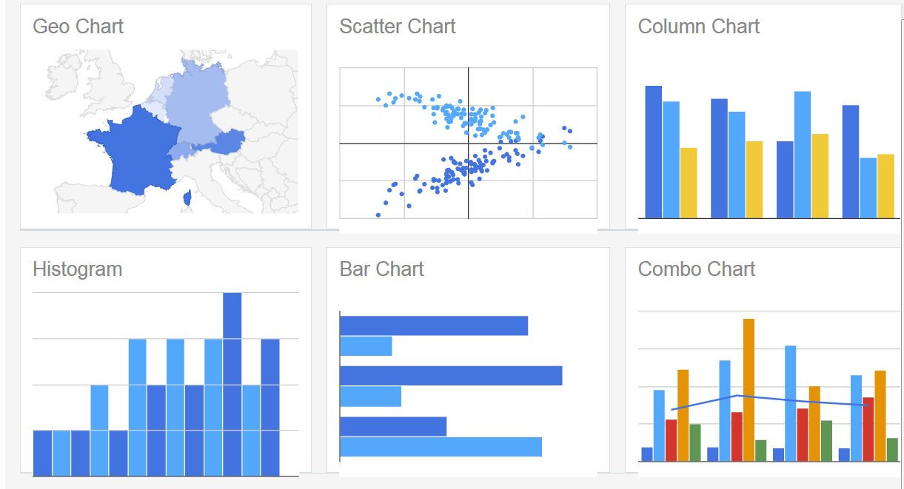
Visualization Types - 1
*https://developers.google.com/chart/interactive/docs/gallery

Slide 4
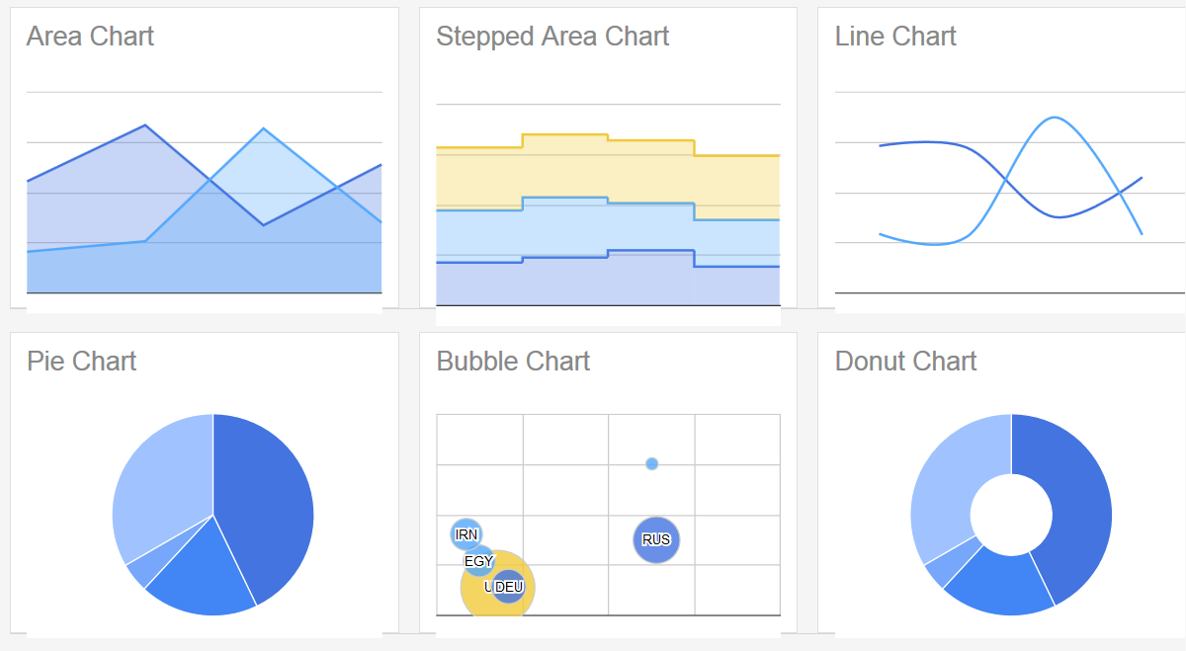
Visualization Types - 2
*https://developers.google.com/chart/interactive/docs/gallery

Slide 5
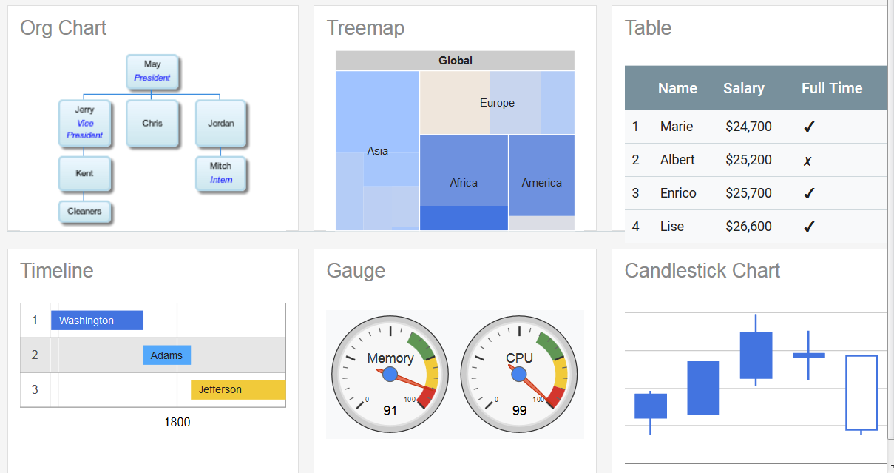
Visualization Types - 3
*https://developers.google.com/chart/interactive/docs/gallery

Slide 6
Choose the effective visualization
Who are your audience ?
What do you want to communicate?
Do they have any background of the data?

Slide 7
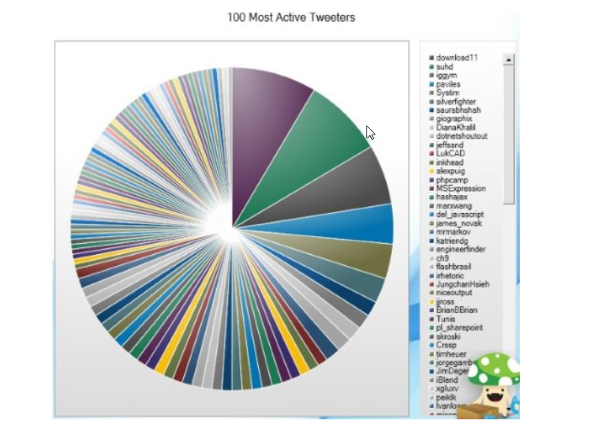
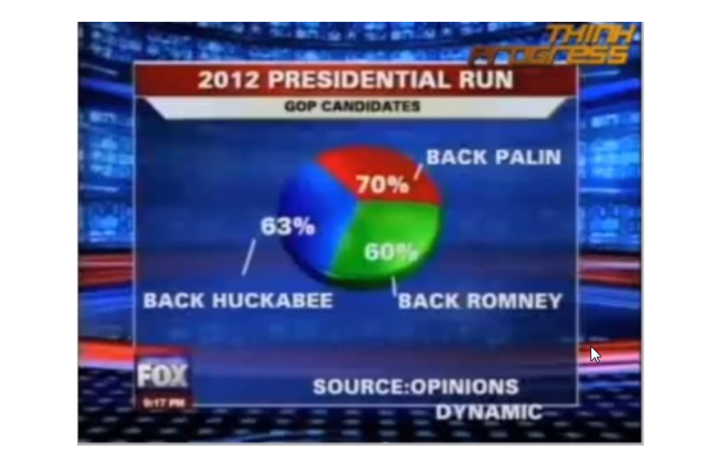
Examples – Bad visualizations examples - 1
*From: Storytelling with data

Slide 8
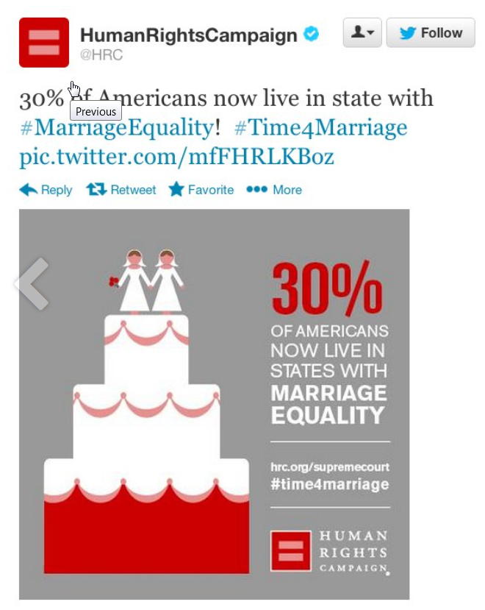
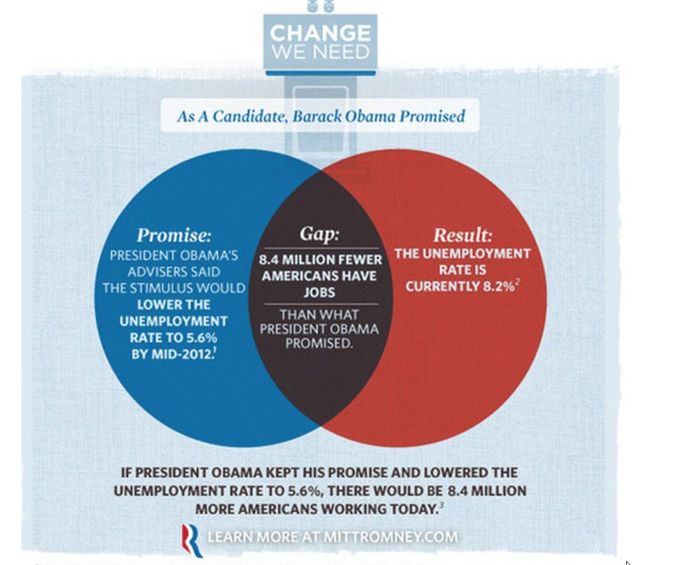
Examples – Bad visualizations examples - 2
*From: Storytelling with data

Slide 9
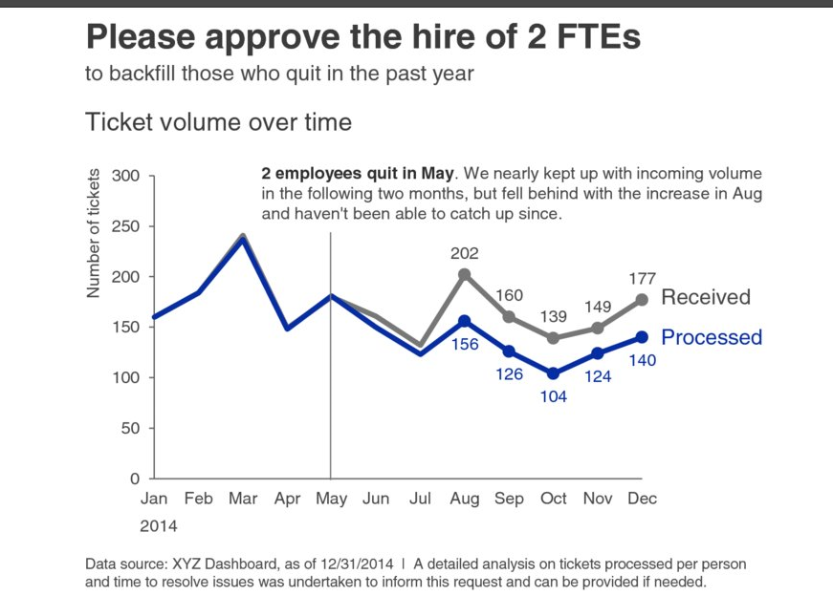
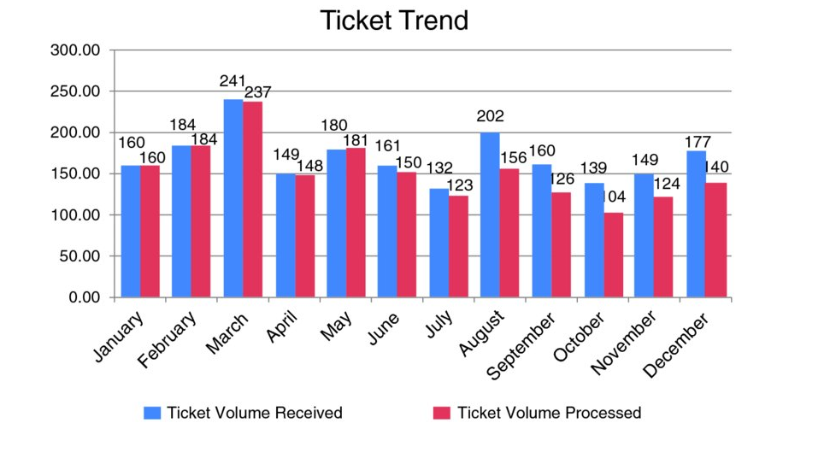
Examples: How to transform your message?
Boring insights
Meaningful insights
*From: Storytelling with data book

Slide 10
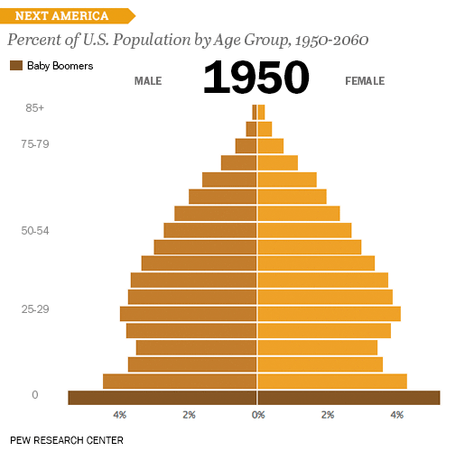
Examples: Powerful message - 1

Slide 11
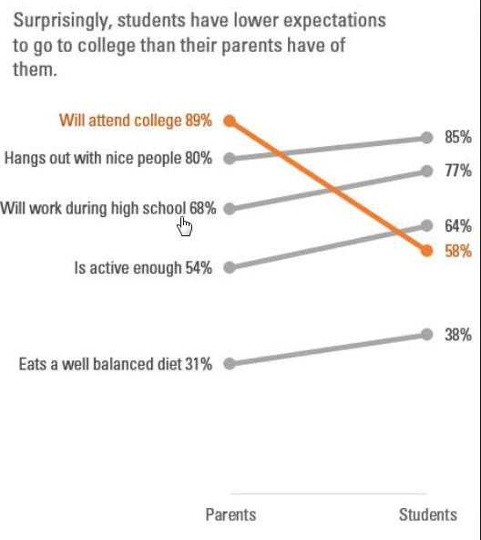
Examples: Powerful message - 2

Slide 12
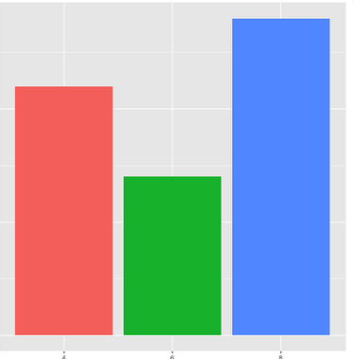
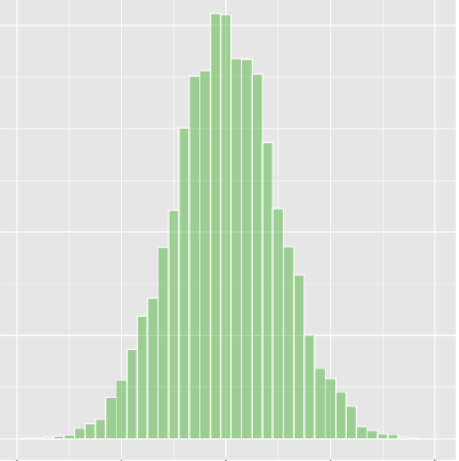
ggplot types - 1
geom_bar()
geom_histogram()
*From: Storytelling with data

Slide 13
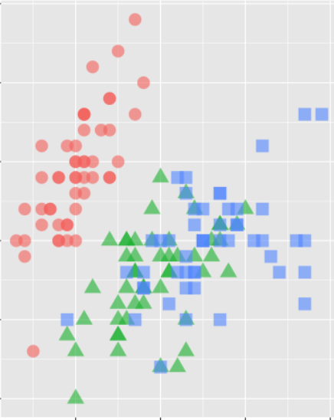
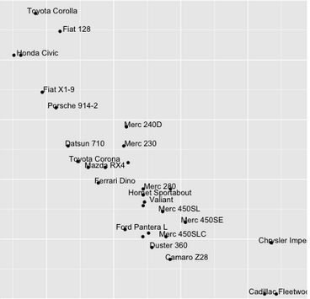
ggplot types - 2
geom_point()
geom_text()
*From: Storytelling with data

Slide 14
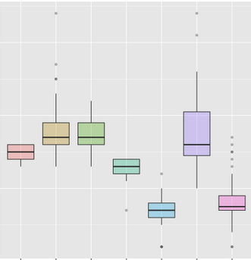
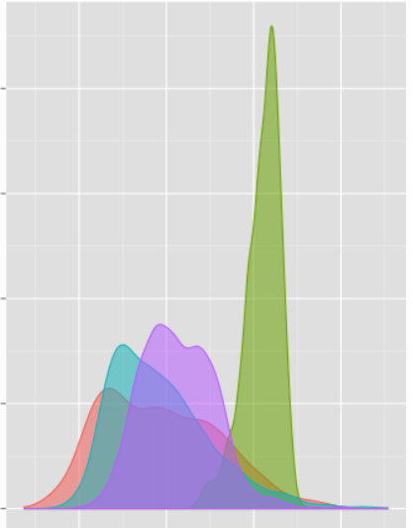
ggplot types - 3
geom_boxplot()
geom_density()
*From: Storytelling with data

Slide 15
Questions to answer
List first 5 good movie which have score above 8
Which film has the highest budget?
How many high score movies do we have? ( high score = imdb score above 8)
Which language has the highest number of movies?
How is the distribution of the movies duration?
Find average number of movies for each language?
Who is the director with highest movie?
Which country is having more movies?
Whose director is having better Imdb score?

